Slide 1
Java EE – Domain Layer

Slide 2
Domain Layer
“… the work that this application needs to do for the domain you're working with. It involves calculations based on inputs and stored data, validation of any data that comes in from the presentation, and figuring out exactly what data source logic to dispatch, depending on commands received from the presentation.” (Fowler)

Slide 3
Different options to organize domain logic
Transaction Script
Domain Model
Table Model
Service Layer

Slide 4
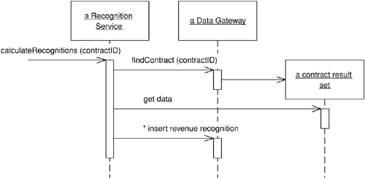
Transaction Script
a procedure that takes the input from the presentation, processes it with validations and calculations, stores data in the database, and invokes any operations from other systems
a single procedure for each action that a user might want to do

Slide 5
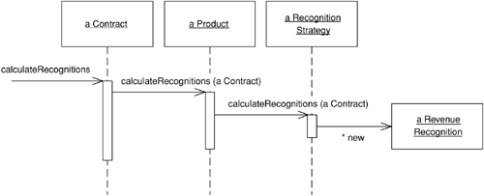
Domain Model
Rather than one routine having all the logic for a user action, each object takes a part of the logic that's relevant to it.

Slide 6
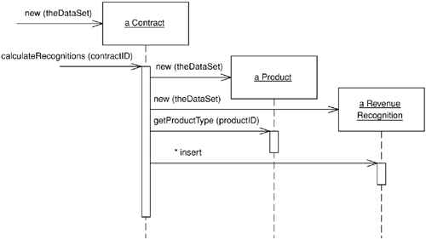
Table Module
has one instance of contract for each contract in the database
If a client wants to do something to an individual contract, it must pass in an ID
You can't use a number of the techniques that a Domain Model uses for finer grained structure of the logic, such as inheritance, strategies, and other OO patterns.

Slide 7
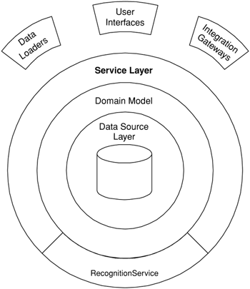
Service Layer
A Service Layer defines an application's boundary and its set of available operations from the perspective of interfacing client layers. It encapsulates the application's business logic, controlling transactions and coordinating responses in the implementation of its operations.

Slide 8
Service Layer
Divide business logic into:
"domain logic," having to do purely with the problem domain (such as strategies for calculating revenue recognition on a contract)
"application logic," having to do with application responsibilities (such as notifying contract administrators, and integrated applications, of revenue recognition calculations).

Slide 9
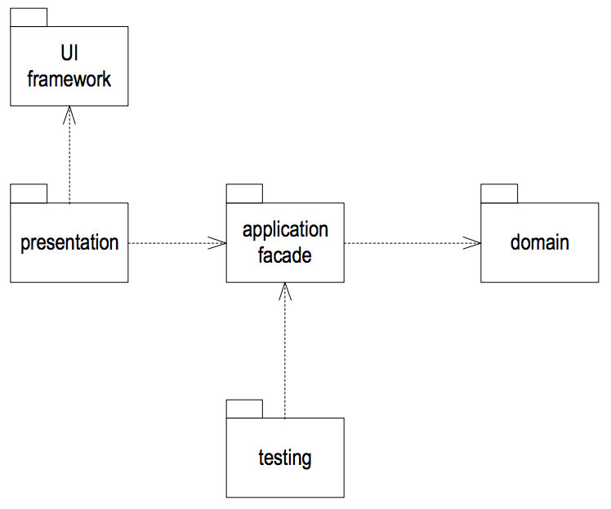
Service Layer is a form of Application Facade
GoF Design Pattern.
The application facade class is responsible for talking to the domain model and getting the information to the presentation class in exactly the form that the presentation class requires.
Notes:
A Facade Controller represents the overall system that encapsulates the domain layer. For example a Catalog object can act as facade for the domain layer containing taxonomies, taxons, product groups, products and variants.
A Use Case Controller is useful for more complex workflows. They are also helpful when a Facade becomes bloated and you wish to split the incoming service requests across multiple Domain Controllers. It’s important to note, you can use more than one Domain Controller for your application. - See more at: http://blog.firsthand.ca/2011/12/your-rails-application-is-missing.html#sthash.wqEbNTO3.dpuf

Slide 10
To Remote or not to Remote
The service layer declares a set of application operations available to interfacing client layers. Therefore, Service Layer classes are well suited to remote invocation from an interface granularity perspective.
Remote invocation comes at the cost of dealing with object distribution.
We need to be able to transfer the data of our domain objects.
Data
Transfer Objects

Slide 11
REST Services
Building a remote service layer

Slide 12
Agenda
What is REST?
Why REST?
Writing RESTFul Web Services in Java
JAX-RS

Slide 13
Different options for remoting
RMI
Classic webservices: SOAP over HTTP
SOAP = XML messages
HTTP = transport protocol
WSDL = XML description of web service interface
Modern webservices: RESTful services

Slide 14
What is REST?
REST answers the questions of
Why is the Web so prevalent and ubiquitous?
What makes the Web scale?
How can I apply the architecture of the web to my applications?

Slide 15
What is REST?
REpresentational State Transfer
PhD by Roy Fielding
The Web is the most successful application on the Internet
What makes the Web so successful?
A different way to look at writing Web Services
Many say it’s the anti-WS-*
REST isn’t protocol specific
But, usually REST == REST + HTTP

Slide 16
What is REST?
Addressable Resources
Every “thing” should have an ID
Every “thing” should have a URI
Every “thing” should be referenceable
Constrained interface
Use the standard methods of the protocol
HTTP: GET, POST, PUT, DELETE, etc.
Resources with multiple representations
Different applications need different formats
Different platforms need different representations (AJAX + JSON)
Communicate statelessly
Stateless application scale

Slide 17
REST vocabulary
A resource is available on the Internet from a URL, and it is possible to interact with it with a set of predefined methods to recover the associated status, update and possibly perform other treatments.
With HTTP, we can take advantage of the different methods (also called verbs) that the protocol provided.
The format of the data exchanged corresponds to the representation. This is a logical structure of data not linked to any particular format such as JSON or XML YAML. This structure can have attributes with nesting levels.
The content of a representation with a particular format is called variant.

Slide 18
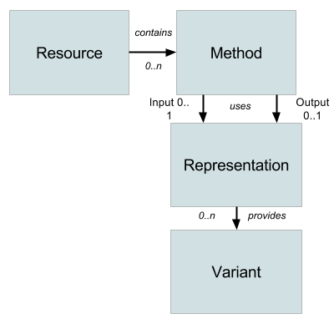
REST vocabulary in a picture

Slide 19
Addressability
Every “thing” has a URI
From a URI we know
The protocol (How do we communicate)
The host/port (Where it is on network)
The resource path(What resource are we communicating with
http://sales.com/customers/323421
http://sales.com/customers/32341/address

Slide 20
Addressability
Its standardized and well-known
Anybody that has used a browser understands URIs
Java EE has no standard addressability for components. Isn’t that a portability headache?
Linkability
Support finds a problem? Have them email you a URI that reproduces the problem
Resource representations have a standardized way of referencing other resource representations
Representations have a standardized way to compose themselves:
<order id=“111”>
<customer>http://sales.com/customers/32133</customer>
<order-entries>
<order-entry>
<quantity>5</quantity>
<product>http://sales.com/products/111</product>
…

Slide 21
Describing a URI
Human readable URIs: Desired but not required. URI Parameters
Query parameters to find other resources
http://sales.com/customers/323421/customers/{customer-id}
http://sales.com/customers?zip=02115

Slide 22
Constrained, Uniform Interface
The idea is to have a well-defined, fixed, finite set of operations
Resources can only use these operations
Each operation has well-defined, explicit behavior
In HTTP land, these methods are GET, POST, PUT, DELETE
How can we build applications with only 4+ methods?
SQL only has 4 operations: INSERT, UPDATE, SELECT, DELETE
Pretty powerful and useful API with constrained interfaces

Slide 23
Implications of a Uniform Interface
Intuitive
You know what operations the resource will support
Predictable behavior
GET - readonly and idempotent. Never changes the state of the resource
PUT - an idempotent insert or update of a resource. Idempotent because it is repeatable without side effects.
DELETE - resource removal and idempotent.
POST - non-idempotent, “anything goes” operation
Clients, developers, admins, operations know what to expect
Much easier for admins to assign security roles
For idempotent messages, clients don’t have to worry about duplicate messages.

Slide 24
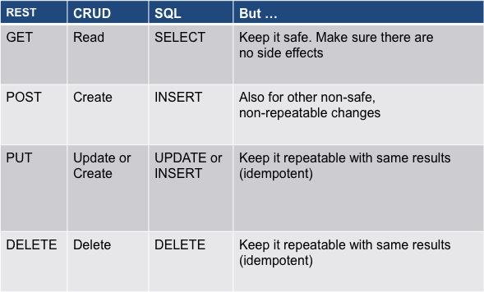
REST Modeling - Methods

Slide 25
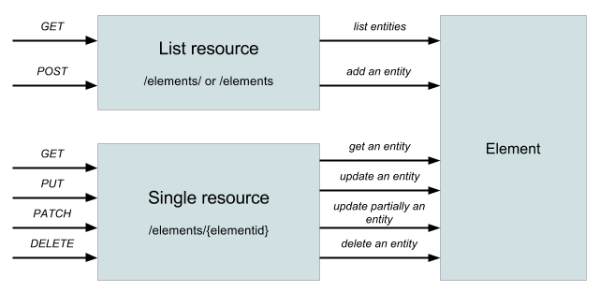
REST Modeling - Methods

Slide 26
Implications of a Uniform Interface
Simplified
Nothing to install, maintain, upgrade
No stubs you have to generate distribute
No vendor you have to pay big bucks to
Platform portability
HTTP is ubiquitous. Most (all?) popular languages have an HTTP client library
Interoperability
HTTP a stable protocol
Ask Xfire, Axis, and Metro how difficult Microsoft interoperability has been
Focus on interoperability between applications rather focusing on the interoperability between vendors.

Slide 27
Implications of Uniform Interface
Familiarity
Operations and admins know how to secure, partition, route, and cache HTTP traffic
Leverage existing tools and infrastructure instead of creating new ones
Easily debugged
How cool is it to be able to use your browser as a debugging tool!

Slide 28
Designing with a Uniform Interface
public interface OrderEntryService {
void submitOrder(Order order);
Order[] getOrders();
void updateOrder(Order order);
void cancelOrder(int orderId);
Order[] getCustomerOrders(Customer customer);
double calculateAverageSale();
}
public interface CustomerService {
void createCustomer(Customer cust);
void deleteCustomer(int custId);
Customer[] getCustomers();
Customer findCustomer(String first, String last);
}

Slide 29
Designing services with a Uniform Interface
When in doubt, define a new resource
/orders
GET - list all orders
POST - submit a new order
/orders/{order-id}
GET - get an order representation
PUT - update an order
DELETE - cancel an order
/orders/average-sale
GET - calculate average sale
/customers
GET - list all customers
POST - create a new customer
/customers/{cust-id}
GET - get a customer representation
DELETE- remove a customer
/customers/{cust-id}/orders
GET - get the orders of a customer

Slide 30
Resources with Multiple Representations
Through URIs and the uniform interface we exchange data
HTTP allows the client to specify the type of data it is sending and the type of data it would like to receive
Depending on the environment, the client negotiates on the data exchange
An AJAX application may want JSON
A Ruby application my want the XML representation of a resource
A server may want to serve up a CSV, MS Excel, or PDF representation of a resource

Slide 31
Resources with Multiple Representations
HTTP Headers manage this negotiation
CONTENT-TYPE: specifies MIME type of message body
ACCEPT: comma delimited list of one or more MIME types the client would like to receive as a response
In the following example, the client is requesting a customer representation in either xml or json format
Preferences are supported and defined by HTTP specification
GET /customers/33323
ACCEPT: application/xml,application/json

Slide 32
REST in Conclusion
REST answers questions of
Why does the Web scale?
Why is the Web so ubiquitous?
How can I apply the architecture of the Web to my applications?
REST is tough to swallow
Make you rethink how you do things
Those with CORBA/WS-* baggage will resist (sometimes violently)
Promises
Simplicity
Interoperability
Platform independence
Change resistance

Slide 33
JAX-RS
RESTFul Web Services in Java

Slide 34
JAX-RS 2.0
JAX-RS 2.0 is the REST development API for Java
Server and client

Slide 35
JAX-RS Annotations
@Path
Defines URI mappings and templates
@Produces, @Consumes
What MIME types does the resource produce and consume
@GET, @POST, @DELETE, @PUT, @HEADER
Identifies which HTTP method the Java method is interested in

Slide 36
JAX-RS Resource Classes
JAX-RS annotations are used on POJO classes
Root resources identified via @Path annotation on class

Slide 37
JAX-RS
@Path(“/orders”)
public class OrderService {
@Path(“/{order-id}”)
@GET
@Produces(“application/json”)
Order getOrder(@PathParam(“order-id”) int id) {
…
}
}

Slide 38
JAX-RS
Base URI path to resource
@Path(“/orders”)
public class OrderService {
@Path(“/{order-id}”)
@GET
@Produces(“application/json”)
Order getOrder(@PathParam(“order-id”) int id) {
…
}
}

Slide 39
JAX-RS
Extension to base URI
that getOrder() method maps to
@Path(“/orders”)
public class OrderService {
@Path(“/{order-id}”)
@GET
@Produces(“application/json”)
Order getOrder(@PathParam(“order-id”) int id) {
…
}
}

Slide 40
JAX-RS
Defines a URI path segment parameter
@Path(“/orders”)
public class OrderService {
@Path(“/{order-id}”)
@GET
@Produces(“application/json”)
Order getOrder(@PathParam(“order-id”) int id) {
…
}
}

Slide 41
JAX-RS
@Path(“/orders”)
public class OrderService {
@Path(“/{order-id}”)
@GET
@Produces(“application/json”)
Order getOrder(@PathParam(“order-id”) int id) {
…
}
}
HTTP method Java getOrder() maps to

Slide 42
JAX-RS
@Path(“/orders”)
public class OrderService {
@Path(“/{order-id}”)
@GET
@Produces(“application/json”)
Order getOrder(@PathParam(“order-id”) int id) {
…
}
}
What’s the CONTENT-TYPE returned?

Slide 43
JAX-RS
@Path(“/orders”)
public class OrderService {
@Path(“/{order-id}”)
@GET
@Produces(“application/json”)
Order getOrder(@PathParam(“order-id”) int id) {
…
}
}
Inject value of URI segment into the id Java parameter

Slide 44
JAX-RS
@Path(“/orders”)
public class OrderService {
@Path(“/{order-id}”)
@GET
@Produces(“application/json”)
Order getOrder(@PathParam(“order-id”) int id) {
…
}
}
Automatically convert URI string segment into an integer

Slide 45
JAX-RS
What CONTENT-TYPE is this method expecting from client?
@Path(“/orders”)
public class OrderService {
@POST
@Consumes(“application/json”)
void submitOrder(String orderJson) {
…
}
}

Slide 46
Noticed the return type for the GET-request?
It says it produces JSON but it returns Order(s)

Slide 47
Configuration
How are the REST resources “found” by the web container?
Register stuff in web.xml (more about that in Java EE – Presentation Layer)
Use a ResourceConfig

Slide 48
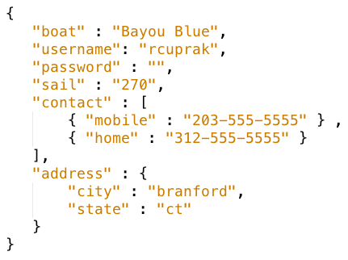
Exchanging Data using JSON
Data is exchanged using JSON (JavaScript Object Notation)
Two data structures: objects and arrays
Types: String, number, object, array, true, false, null.
Extremely compact and simple to exchange

Slide 49
Default Response Codes
GET and PUT
200 (OK)
DELETE and POST
200 (OK) if content sent back with response
204 (NO CONTENT) if no content sent back

Slide 50
RESTful Web Services
Client/server communication from mobile applications commonly happens over HTTP, more often using REST style services
Stateless, lightweight, scalable
Typically JSON over HTTP/HTTPS.
XML occasionally used.
Client initiates the request.
Commonly supported HTTP verbs include GET, POST, PUT, and DELETE
Uses existing web technologies and security standards
Fully supported by Java EE 6 & 7.

Slide 51
Resources
http://martinfowler.com/apsupp/appfacades.pdf
Patterns of Enterprise Application Architecture, Fowler
http://www.programmableweb.com/news/how-to-easily-develop-web-apis-apispark/sponsored-content/2015/06/25

